Slide 1
Please make sure there’s a “Module Transition” slide for every module
03 | Web API Configuration
Jeremy Likness | Principal Architect
Christopher Harrison | Content Developer

Slide 2
Module Overview
Please leave this area blank to allow for picture in picture recording
Media Formatters
Camel Case and Serializers
Routes and Actions
Attribute Routing
Custom Content Negotiation

Slide 3
Media Formatters
Please leave this area blank to allow for picture in picture recording
Media type = MIME type
Examples: text/html, application/xml, application/json
Accept (what it wants), Content-Type (what it gets)
Built in formatters: XML, JSON, BSON, form-encoded
Create custom with MediaTypeFormatter, BufferedMediaTypeFormatter

Slide 4
Custom Media Formatter: CSV Export
Please leave this area blank to allow for picture in picture recording
Notes:
03aCustomMediaFormatters

Slide 5
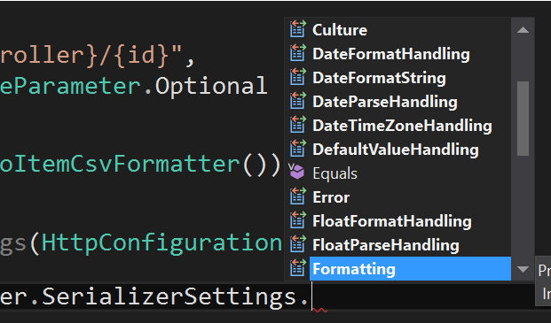
Camel Case and Serializers
Please leave this area blank to allow for picture in picture recording
MediaFormatter performs serialization
Several SerializerSettings

Slide 6
Proper JavaScript Case
Please leave this area blank to allow for picture in picture recording

Slide 7
Routes and Actions
Please leave this area blank to allow for picture in picture recording
Route template
Api/{controller}/public/{resource}/{id}
controller = controller name
action = action (usually omitted)
Provide default values
defaults: new { resource = “widgets” }
Constrain
constraints: new { id = @”\d+” }
Optional
RouteParameter.Optional

Slide 8
Routes and Actions
Please leave this area blank to allow for picture in picture recording
Select Controller
Route Dictionary
{controller}+ Controller
{controller} [type]
Select Action
HTTP Method
{action}
(params)
Controller .Method()

Slide 9
Attribute Routing
Please leave this area blank to allow for picture in picture recording
Child resources
Add the attribute to the controller action
Must enable in configuration:
config.MapHttpAttributeRoutes();
Use RoutePrefix for a common prefix on the controller
tilde to override (i.e. “~/api/overrideprefix”)
May include parameters
Pass constraints (int, alpha, bool, etc.)

Slide 10
Routing and Actions
Please leave this area blank to allow for picture in picture recording
Notes:
03bRoutingActions

Slide 11
Custom Content Negotiation
Please leave this area blank to allow for picture in picture recording
MediaTypeMappings
QueryStringMapping
UriPathExtensionMapping
RequestHeaderMapping
Own Formatter
Derive from default, override MathRequestMediaType
Implement IContentNegotiator

Slide 12
Case Study: GitHub API
Please leave this area blank to allow for picture in picture recording
Notes:
https://developer.github.com/v3/ -> start at https://api.github.com/users/jeremylikness and drill down

